Slide 1
Hospital stay duration
MSDS 6372 Project 1
Miguel Zavala | ahmad salama | arman azhand

Slide 2
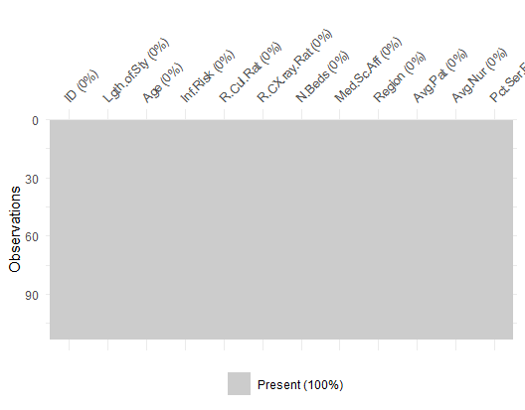
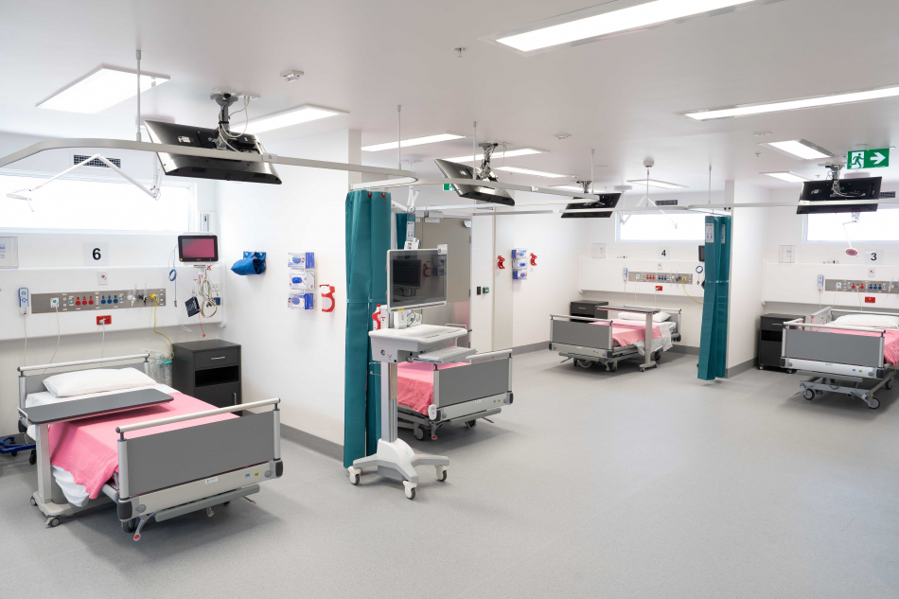
What is our data?
113 observations
13 variables:
1 identifier (not used)
1 response variable
8 continuous variables (numeric)
2 categorical variables
No missing values for any observation!
Hospital ID | Identifier variable
Length of Stay | Average length of stay (in days)
Age | Average age of patients (years)
Infection Risk | Average estimated probability of hospital infection
Routine culturing ratio | Ratio of # of cultures performed to number of patients without symptoms of infection times 100
Routine chest x-ray ratio | Ratio of # of cultures performed to number of patients without symptoms of pneumonia times 100
Number of beds | Average number of beds
Medical School Affiliation | Yes or No (1, 2)
Region | Geographic region: NE, NC, S, W (1, 2, 3, 4)
Average Daily census | Average number of patients in hospital per day
Number of nurses | Average number of full-time nurses
Available facilities | Percent of 35 potential facilities and services that are provided by the hospital
Length of Stay | Average length of stay (in days)
Age | Average age of patients (years)
Infection Risk | Average estimated probability of hospital infection
Routine culturing ratio | Ratio of # of cultures performed to number of patients without symptoms of infection times 100
Routine chest x-ray ratio | Ratio of # of cultures performed to number of patients without symptoms of pneumonia times 100
Number of beds | Average number of beds
Medical School Affiliation | Yes or No (1, 2)
Region | Geographic region: NE, NC, S, W (1, 2, 3, 4)
Average Daily census | Average number of patients in hospital per day
Number of nurses | Average number of full-time nurses
Available facilities | Percent of 35 potential facilities and services that are provided by the hospital
Length of Stay | Average length of stay (in days)
Age | Average age of patients (years)
Infection Risk | Average estimated probability of hospital infection
Routine culturing ratio | Ratio of # of cultures performed to number of patients without symptoms of infection times 100
Routine chest x-ray ratio | Ratio of # of cultures performed to number of patients without symptoms of pneumonia times 100
Number of beds | Average number of beds
Medical School Affiliation | Yes or No (1, 2)
Region | Geographic region: NE, NC, S, W (1, 2, 3, 4)
Average Daily census | Average number of patients in hospital per day
Number of nurses | Average number of full-time nurses
Available facilities | Percent of 35 potential facilities and services that are provided by the hospital
Length of Stay | Average length of stay (in days)
Age | Average age of patients (years)
Infection Risk | Average estimated probability of hospital infection
Routine culturing ratio | Ratio of # of cultures performed to number of patients without symptoms of infection times 100
Routine chest x-ray ratio | Ratio of # of cultures performed to number of patients without symptoms of pneumonia times 100
Number of beds | Average number of beds
Medical School Affiliation | Yes or No (1, 2)
Region | Geographic region: NE, NC, S, W (1, 2, 3, 4)
Average Daily census | Average number of patients in hospital per day
Number of nurses | Average number of full-time nurses
Available facilities | Percent of 35 potential facilities and services that are provided by the hospital
Length of Stay | Average length of stay (in days)
Age | Average age of patients (years)
Infection Risk | Average estimated probability of hospital infection
Routine culturing ratio | Ratio of # of cultures performed to number of patients without symptoms of infection times 100
Routine chest x-ray ratio | Ratio of # of cultures performed to number of patients without symptoms of pneumonia times 100
Number of beds | Average number of beds
Medical School Affiliation | Yes or No (1, 2)
Region | Geographic region: NE, NC, S, W (1, 2, 3, 4)
Average Daily census | Average number of patients in hospital per day
Number of nurses | Average number of full-time nurses
Available facilities | Percent of 35 potential facilities and services that are provided by the hospital
Length of Stay | Average length of stay (in days)
Age | Average age of patients (years)
Infection Risk | Average estimated probability of hospital infection
Routine culturing ratio | Ratio of # of cultures performed to number of patients without symptoms of infection times 100
Routine chest x-ray ratio | Ratio of # of cultures performed to number of patients without symptoms of pneumonia times 100
Number of beds | Average number of beds
Medical School Affiliation | Yes or No (1, 2)
Region | Geographic region: NE, NC, S, W (1, 2, 3, 4)
Average Daily census | Average number of patients in hospital per day
Number of nurses | Average number of full-time nurses
Available facilities | Percent of 35 potential facilities and services that are provided by the hospital

Slide 3

Objectives
Two main objectives
Is infection risk (and related factors) associated with a patient’s length of stay after accounting for other variables?
Fit multiple models to predict future patients’ hospital stays and compare the models to one another.

Slide 4

Exploratory data analysis
Taking a closer look at our data and exploring the relationships each variable has with one another.

Slide 6
Objective 1
Is infection risk (and related factors) associated with a patient’s length of stay after accounting for other variables?

Slide 7
Objective 2
Fit multiple models to predict future patients’ hospital stays and compare the models to one another.

Slide 8
Multiple linear regression (model 2)

Slide 9
Nonparametric approach (model 3)

Slide 10
Comparison of Model error metrics
Model | Error Metric
Linear Regression (variables here)
Complex Linear Regression (variables here)
Nonparametric approach *whichever one we chose* (variables/hyperparameters here)

Slide 11
Summary and Final remarks
With this product, Adatum Corporation is positioned for success in the dynamic market.
With a focus on innovation, user experience, and strategic growth, we anticipate reaching new heights in the coming year.
Our commitment to user satisfaction underscores every aspect of our operations
Strong market positioning
Robust growth strategy
Innovative product development
Commitment to user satisfaction

Slide 12

Thank you
Miguel Zavala | ahmad salama | arman azhanD
mzavalagamero@mail.smu.edu | asalama@mail.smu.edu | aazhand@mail.smu.edu

